Slide 1



Slide 2

1 Introduction
2 Drawback of Sequential Storage
3 Concept of Linked List
4 Implementation of Linked List
5 Operation of Linked List
Creating a List
Displaying a List
Inserting an element in the List
6 Deleting an element
7 Other Operation & Applications

Slide 3

As an abstract data type,
a list is a finite sequence (possibly empty) of elements with basic operations that vary from one application to another.
Basic operations commonly include:
Construction: Allocate and initialize a list object (usually empty)
Empty: Check if list is empty
Traverse: Visit each element of the list in order stored
Insert: Add an item to the list (at any point)
Delete: Remove an item from the list (at any point)

Slide 4
Static implementation of list( Sequential storage of Array)
1. Simple to use
2. Simple to define
3. Constant access time
4. Mapping by compiler
5. Size of array is defined at time of programming.
i.e. Size of array is fixed. we can't insert more elements beyond the size.
6. Insertion & deletion from Array
consider int a[4];
After deleting the data 14 it becomes
11 | 12 | 13 | 14 | 15
11 | 12 | 13 | 0 | 15

Slide 5
Limitations of Sequential Representation (Arrays)
An array is a static data structure. i.e. the size of an array remains fixed. Moreover, if we require more space than allocated, it cannot be increased during run time.
Most real applications process variable size data. The amount of data to be manipulated and hence the storage requirements cannot be predicted in advance during design time.
Often, we need to insert, delete, move and record data. For this, a lot of elements will have to be moved, which will require a lot of processing time. If these operations are to be carried out very frequently, the processing time will be enormous.

Slide 6
Advantages of Linked List:
1. Linked List is an example of Dynamic Data Structure. They can grow & shrink during execution of the program.
2. Representation of linear data structure ( polynomial, stack & queue)can be easily represented using Linked List.
3. Efficient memory utilization. Memory is not pre-allocated like array. Memory is deallocated when it is no longer need.
4. Insertion & deletion are easier & efficient. It can be carried out in constant time.

Slide 7
A
B
C
NULL
Head
A linked list is a series of connected nodes
Each node contains at least
  A piece of data (any type)
  Pointer to the next node in the list
Head: pointer to the first node
The last node points to NULL
node
A
data
pointer

Slide 8
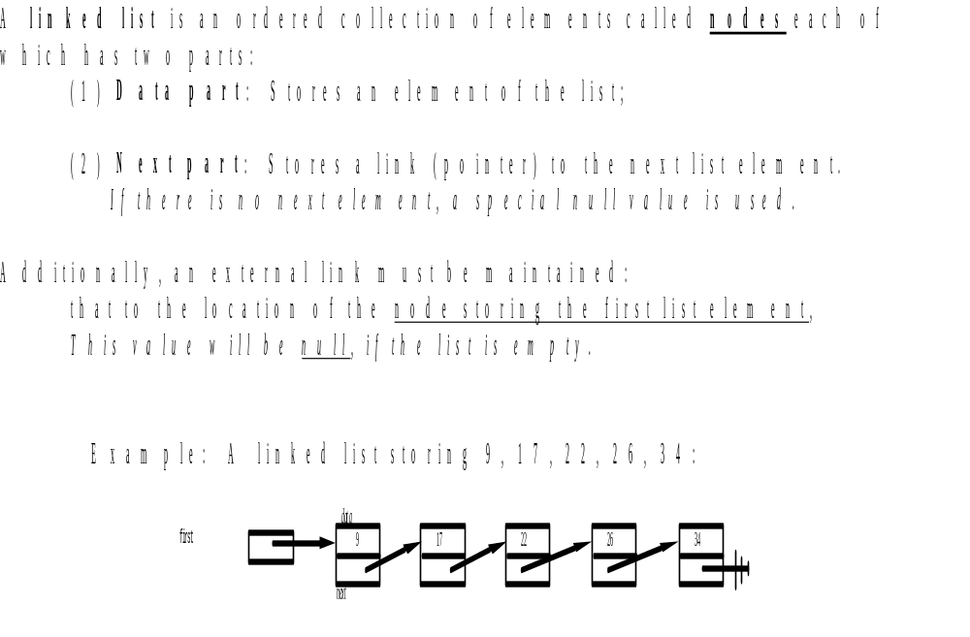

Slide 9
Types of linked lists:
  1. Singly linked list
    Begins with a pointer to the first node
    Terminates with a null pointer
    Only traversed in one direction
  2. Circular, singly linked
    Pointer in the last node points back to the first node
    Advantage over SLL: Accessing any node from list become very easy. In SLL to access any node we have to traverse whole list from the first node. But in CLL link of the last node points to the first node of list which represents the list in circular way. (Suppose PTR is on last node & we want to access the 2nd node)
5
1
2
3
5
1
2
3

Slide 10
    3. Doubly linked list
    Two “start pointers” – first element and last element
    Each node has a forward pointer and a backward pointer
    Allows traversals both forwards and backwards
  4. Circular, doubly linked list
    Forward pointer of the last node points to the first node and backward pointer of the first node points to the last node
 | 5
 | 1
 | 2
 | 5
 | 1
 | 2

Slide 11

      class node
      {
      public:
      int data;
      node *next;
      };
      This class is called as self referential structure
      The pointer Next points to the address of the next Node.
      node *ptr;
      ptr = new node();

Slide 12
Basic operations on Linked List:
1. Creating a linked list
2. Traversing the linked list.
3. Printing the linked list
4. Counting the nodes in the linked list
5. Searching the item in the linked list
6. Inserting a node
a. At the beginning
b. At the end
c. At the location of given ITEM(data)

Slide 13
7. Deleting a node
a. Deletion of first node
b. Deletion of last node
c. Deletion of a node with given ITEM of information
8. Concatenation of two nodes
9. Inversion of the list (Reverse)
10. Sorting of elements stored in a linked list
11. Merging of two sorted linked list
12. Separating a linked list in two linked list

Slide 14

Using structure
struct definition
typedef struct node
{
int data;
struct node *next;
};
node *head=NULL;
Using Class
Class definition
class node
{
public:
int data;
node *next;
};

Slide 15
      void Linklist::create()
      { node *newn,*c;
      int tot,v,i;
      char ch;
      cout<<"\nHow many nodes u want ?";
      cin>>tot;
      for(i=0;i<tot;i++)
      { cout<<"\nEnter data ";
      cin>>v;
      newn=new node();
      newn->data=v;
      newn->next=NULL;
      if(head==NULL)
      h=newn;
      else
      c->next=newn;
      c=newn;
      }
      }

Slide 16

void display()
{
node *p;
p=head;
cout<<"\nThe list is ";
while(p!=NULL)
{
cout<<"\t "<<p->data<<"-> ";
p=p->next;
}
cout<<"\n";
}

Slide 17

void Linklist::search()
{ node *p;
int data, loc=1;
cout<<"\nEnter the data to be searched: ";
cin>>data;
p=head;
while(p!=NULL && p->data != data)
{ loc++;
p=p->next;
}
if(p==NULL)
cout<<"\nNot found:";
else
cout<<"\nFound at location "<<loc;
}

Slide 18

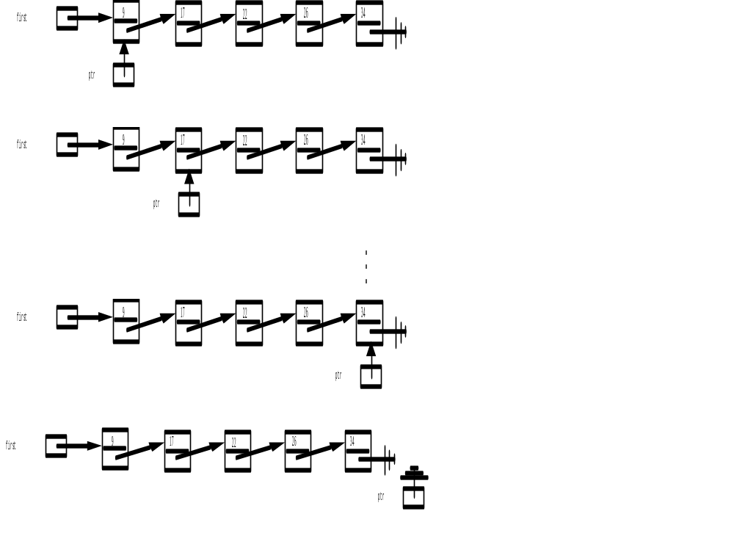

Slide 19
#include<iostream.h>
#include<conio.h>
class node
{ public:
int data;
node *next;
};
class SLL
{
private:
node *head;
public:
SLL();
void create();
void display();
};

Slide 20
SLL::SLL()
{
head=NULL;
}
void SLL::create()
{
node *newn,*c;
int tot,v,i;
char ch;
cout<<"\nHow many nodes u want ?";
cin>>tot;
for(i=0;i<tot;i++)
{
cout<<"\nEnter data ";
cin>>v;

Slide 21
newn=new node();
newn->data=v;
newn->next=NULL;
if(head==NULL)
head=newn;
else
c->next=newn;
c=newn;
}
}

Slide 22
void SLL::display()
{
node *p;
p=head;
cout<<"\nThe list is ";
while(p!=NULL)
{
cout<<"\t "<<p->data<<"-> ";
p=p->next;
}
cout<<"\n";
}

Slide 23


Slide 24

You have a linked list
  Perhaps empty, perhaps not
  Perhaps ordered, perhaps not
You want to add an element into the linked list
head
48
17
142
//

Slide 25

Involves two steps:
Finding the correct location
Doing the work to add the node

Slide 26

Three possible positions:
  The front
  The end
  Somewhere in the middle

Slide 27

head
93
48
17
142
head
There is no work to find the correct location
Empty or not, head will point to the right location

Slide 28

head
48
17
142
//
93
//
Find the end of the list
(when at NULL)
  Recursion or iteration

Slide 29

head
17
48
142
//
//
93
142
Used when order is important
Go to the node that should follow the one to add
  Recursion or iteration

Slide 30

To front
  No recursion needed
To end
  Get to the end, then add node
In order (in middle)
  To maintain sorted property

Slide 31

Need an in/out pointer parameter
Create new node
Fill in data
Make new node’s next pointer point to current
Update current to point to new node

Slide 32

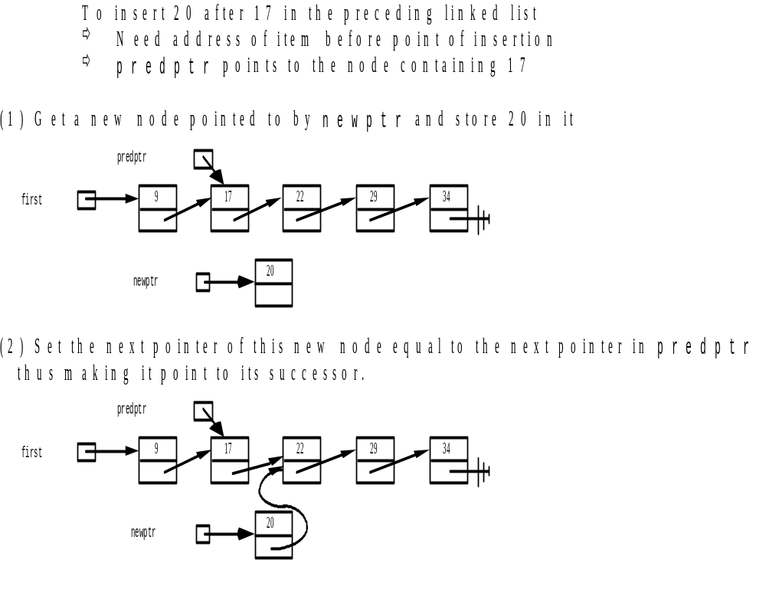

Slide 33
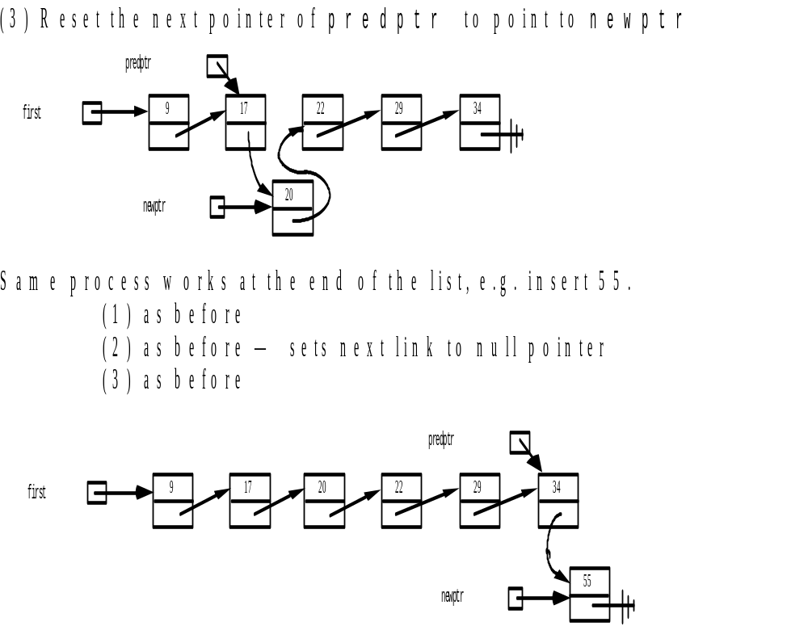

Slide 34
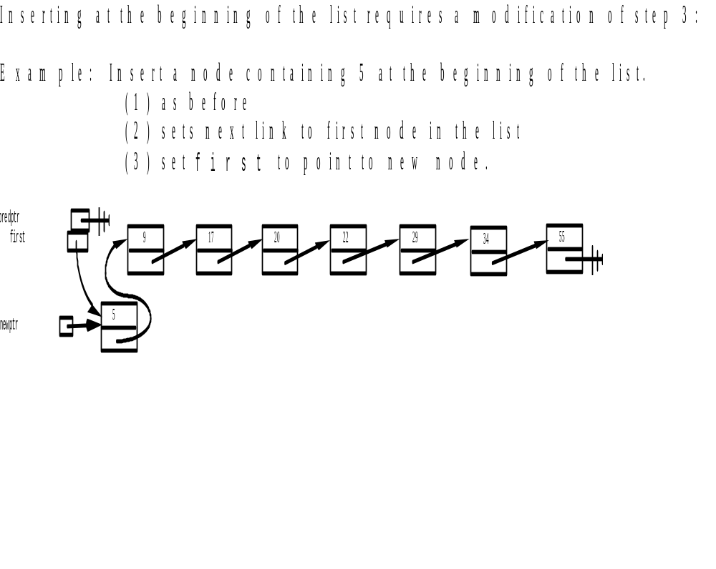

Slide 35
Algorithm for insertion of a node at the front of the List
INSERT_AT_BEG(head, int x)
// Node is a class used to represent linked list in memory.
// head is starting node from a linked list
1. Create a new node newn pointer.
2. Assign data part and next part of newn node. Data part will get initialized by accepting value from user.
Assign the next part to header node.
newn=new node();
newn->data=x;
newn->next=head;
3. Assign the address of new node to header.
head=newn;
4. Stop

Slide 36

void SLL::insert_beg()
{
node *newn; //new node
int x;
cout<<"\nEnter the data for the new node";
cin>>x;
newn=new node;
newn->data=x;
newn->next=head;
head=newn;
}

Slide 37
Algorithm for insertion of a node at the end of the List
Algorithm:
INSERT_AT_END(head, int x)
Node is a class used to represent linked list in memory.
head is starting node from a linked list
1. Create a new node newn pointer.
2. Assign data part and next part of newn node. Data part will get initialized by accepting value from user.
Assign the next part to header node.
newn=new node();
newn->data=x;
2 a) Move the address of the HEADER node to the pointer Q
q = head
b) Now traverse the list until the last node
while (q.next not equal to NULL)
i.e. q = q.next
c) When q.next becomes NULL then q is pointing to the last node in the list
i) Attach the new node address in the NEXT field of the last
node q q->next=newn;
3. Stop

Slide 38
Function for Insertion of a node at the end
void SLL::insert_end()
{
node *p,*q,*newn;
int x;
cout<<"\nEnter data at the end ";
cin>>x;
newn=new node;
newn->data=x;
newn->next=NULL;
if(head==NULL)
head=newn;
//locate the last node
for(q=head;q->next!=NULL;q=q->next)
;
q->next=newn;
}

Slide 39
Algorithm for insertion of a node after the given data
Algorithm:
INSERT_AT_END(head, int x)
Node is a structure used to represent linked list in memory.
head is starting node from a linked list
1. Create a new node newn pointer.
2. Assign data part and next part of newn node. Data part will get initialized by accepting value from user.
Assign the next part to header node.
newn=new node();
newn->data=x;
2 a) Move the address of the HEADER node to the pointer Q
q = head
b) Get the data item of the Node key after which the new node
has to be placed
c) Now traverse the list from HEADER node to find the node which contains key as the data item.
while (q.data is not equal to y) and (q. next is not equal to NULL)
q = q.next
If (q.next is NULL)
cout<< “ The Key is not available in the list”
Exit

Slide 40
a) Make the next field of the new node to point the node pointed out by q.
newn->next=q->next;
q->next=newn;
4. Stop

Slide 41
Insertion of a node in between two nodes
void Linklist::insert_in()
{
node *newn,*q;
int y,x;
newn=new node;
cout<<"\nEnter the data for new node ";
cin>>x;
newn->data=x;
newn->next=NULL;
cout<<"\Insert after which number ? : ";
cin>>y;
for(q=head ; q != NULL && q->data != y ; q=q->next) //locate the lthe data 'y‘
;
if(q!=NULL)
{ newn->next=q->next;
q->next=newn;
}
else
cout<<"\nData not found ";
}

Slide 42
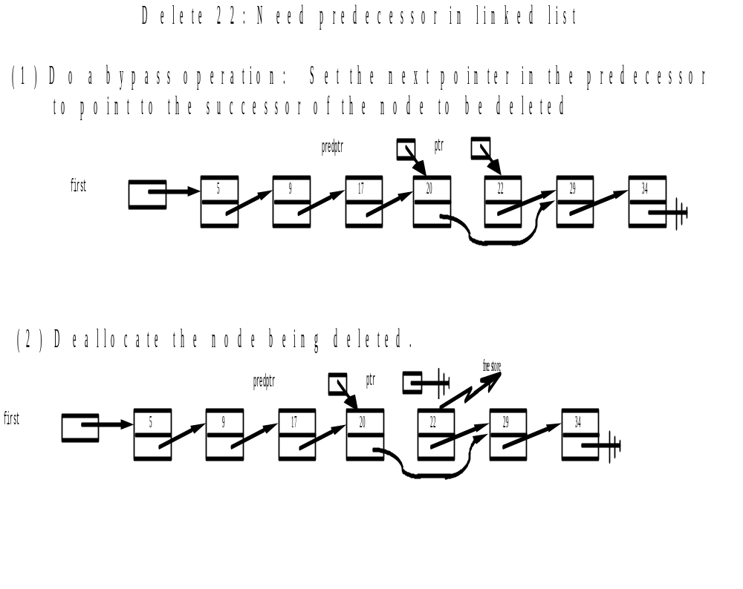
Linked List Delete

Slide 43
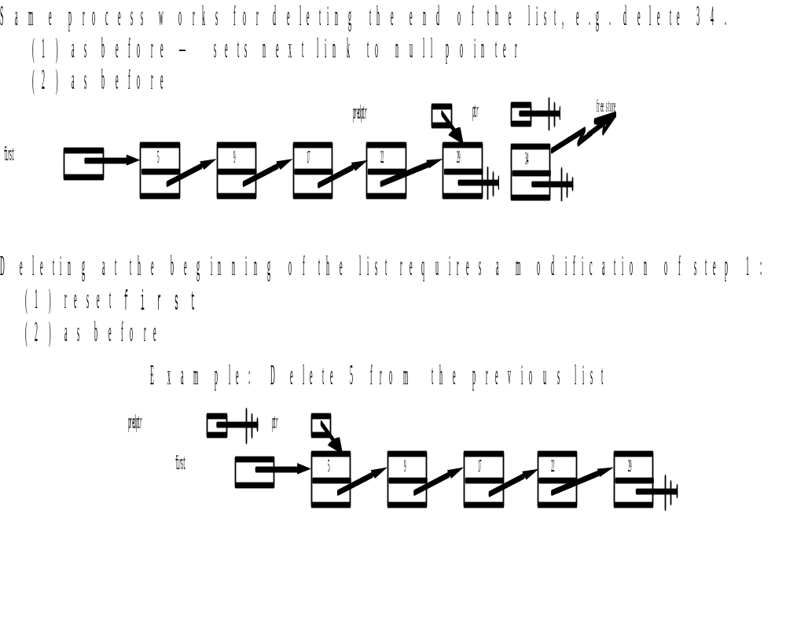
Linked List Delete

Slide 44
void Linkedlist::delete_node()
{
int d;
struct node *ptr,*pre;
cout<<"\nEnter the data to delete ";
cin>>d;
if(head==NULL)
{
cout<<"\nThe list is empty ";
return;
}
if(head->data==d) /* First node deleted */
{
ptr=head;
head=head->next;
delete(ptr);
return;
}

Slide 45
ptr=head;
while(ptr->next!=NULL) /* Node deleted in between */
{
if(ptr->data==d)
{
pre->next=ptr->next;
delete(ptr);
return;
}
pre=ptr;
ptr=ptr->next;
}
if(ptr->data==d) /* Last node deleted */
{
pre->next=ptr->next;
delete(ptr);
return;
}
cout<<"\n"<<d <<" Data not found \n";
}

Slide 46
Inversion / Reverse of the linked list :
5
1
2
3
Original list
5
1
2
3
Linked list after reversal of the first node
5
1
2
3
Linked list after reversal of the first two node
5
1
2
3
Linked list after reversal of all nodes

Slide 47
function for inversion/ Reverse without Recursion:
        void SLL::rev_nonrec()
        { node *p1,*p2,*p3;
        if(head->next==NULL) /*only one element*/
        return;
        p1=head;
        p2=p1->next;
        p3=p2->next;
        p1->next=NULL;
        p2->next=p1;
        while(p3!=NULL)
        { p1=p2;
        p2=p3;
        p3=p3->next;
        p2->next=p1;
        }
        head=p2;
        display();
        }/*End of rev()*/

Slide 48
Inversion /Reverse of the linked list :
p2
p3
p1
3
5
1
2
Initial value of p1, p2, p3
p2
p3
5
1
2
3
p1
After removing the first node (q->next = p)
p1
p2
p3
5
1
2
3
After moving p1, p2, p3 forward(p1=p2, p2=p3)

Slide 49

        void SLL::rev_rec()
        {
        node *st;
        st=head;
        rev1(st);
        }
        void SLL::rev1(node *st)
        {
        if(st!=NULL)
        {
        rev1(st->next);
        cout<<st->data<<" ,";
        }
        }

Slide 50

        void SLL::count()
        {
        node *q=head;
        int cnt=0;
        while(q!=NULL)
        {
        q=q->next;
        cnt++;
        }
        cout<<"\t\tNumber of elements are \n"<<cnt;
        }/*End of count() */

Slide 51
CPP Program to perform the operations on Linked List as
Create
Display
Insert a node at the beginning
Insert a node at the end
Insert in between any two nodes
Delete a node
Count the number of nodes
Search a node
Reverse of a list

Slide 52
Concatenation of Two Linked Lists
Head 1
P
Head 2

Slide 53
function to concatenate two linked list
node * concatenate(node * head1, node *head2)
{
node *p;
if (head1==NULL) /* If 1st list is empty */
return(head1);
if (head2==NULL) /* If 2nd list is empty */
return(head2);
p=head1; /* place p on the first node of the first
linked list */
while(p->next != NULL) /* Move p to last */
p=p->next;
p->next=head2; /* addr of last node from head1 stored
in 1st node of head2 list */
return(head1);
}

Slide 54
Sorting of all data in the linked list
void sort(node *head)
{
int i,j,n,temp;
node *p; /*counting number of nodes*/
for (n=0,p=head; p!=NULL; p=p->next)
n++;
for (i=1;i<n; i++)
{ p=head;
for (j=0;j<n-1 ;j++)
{ if (p->data > p->next->data)
{ temp=p->data;
p->data=p->next->data;
p->next->data=temp;
}
p=p->next;
}
} }

Slide 55

In this linked list the last node contains the address of first/header node.
5
1
2
3

Slide 56
Operations on CLL (Circular Linked List)
Creation of CLL:
void CLL::create()
{ node * newn,*c;
int v,i,tot;
cout<<"\nHow many nodes u want ?";
cin>>tot;
for(i=0;i<tot;i++)
{
cout<<"\n Enter data:"; cin>>v;
newn=new node();
newn->data=v;
newn->next=NULL;
if(head==NULL)
{ head=newn;
newn->next=head;
}else
{ c->next=newn;
newn->next=head;
} c=newn; } }

Slide 57

      void CLL::display()
      {
      node *p;
      p=head;
      cout<<"\nThe list is ";
      while(p->next!=head)
      {
      cout<<"\t "<<p->data<<"-> ";
      p=p->next;
      }
      cout<<p->data<<"\n";
      }

Slide 58
Insertion of a node at the beginning
head
5
1
2
3
head
7
5
1
2
3

Slide 59
      void CLL::insert_beg()
      { node *p,*q,*newn;
      int x;
      cout<<"\nEnter data at the end ";
      cin>>x;
      newn=new node;
      newn->data=x;
      newn->next=NULL;
      p=head;
      while(p->next!=head)
      {
      p=p->next;
      }
      p->next=newn;
      newn->next=head;
      head=newn;
      }

Slide 60
Insert a node at the end of the list
      void CLL::insert_end()
      {
      node *p,*q,*newn;
      int x;
      cout<<"\nEnter data at the end ";
      cin>>x;
      newn=new node;
      newn->data=x;
      newn->next=NULL;
      p=head;
      while(p->next!=head)
      {
      p=p->next;
      }
      p->next=newn;
      newn->next=head;
      }

Slide 61
Insert a node after given data
q
5
1
2
3
1
newnode

Slide 62
      void CLL::insert_in()
      { node *newn,*q;
      int y,x;
      newn=new node;
      cout<<"\nEnter the data for new node ";
      cin>>x;
      newn->data=x;
      newn->next=NULL;
      cout<<"\Insert after which number ? : ";
      cin>>y;
      //locate the lthe data 'y'
      for(q=head ; q != NULL && q->data != y ; q=q->next)
      ;
      if(q!=NULL)
      { newn->next=q->next;
      q->next=newn; }
      else
      cout<<"\nData not found “; }

Slide 63
Deletion of a node for given ITEM of information
void del(int num)
{ node *q;
if ( head-> next==head && head ->data==num) /* Only one element */
{ tmp = head;
head = NULL;
delete (tmp);
return;
}
q = head -> next;
if ( q -> data== num) /* first node */
{ tmp= q;
head -> next = q -> next;
delete( tmp);
return;
}

Slide 64
while( q ->next !=head) /*element deleted in between */
{ if (q -> next-> data==num)
{ tmp = q -> next;
q -> next= tmp -> next;
delete(tmp);
cout<<num<<“ deleted ”;
return;
}
q = q -> next;
}
If ( q -> next-> data== num) /* last element deleted */
{ tmp = q -> next;
q -> next= head-> next;
delete(tmp);
return;
}

Slide 65
CPP Program to perform the operations on Circular Linked List as
Create
Display
Insert a node at the beginning
Insert a node at the end
Insert in between any two nodes
Delete a node
Count the number of nodes
Search a node
Reverse of a list

Slide 66

Singly linked list is one directional list. We can’t do operations on previous node. Each time traversing from start node is required.
To avoid this Doubly linked list is created. It contains the address of previous & next node

Slide 67

Previous Pointer | Data | Next Pointer
class node
{
int data;
struct node *next,
struct node*prev;
};

Slide 68


Slide 69
void DLL::create()
{
int ch;
struct node * c,*newn;
int tot;
cout<<"\nHow many nodes u want ?";
cin>>tot;
for(int i=0;i<tot;i++)
{
cout<<"\n Enter data:";
cin>>ch;
newn=new node;
newn->data=ch;
newn->next=NULL;
newn->prev=NULL;

Slide 70
if(head==NULL)
{
head=newn;
}
else
{
c->next=newn;
newn->prev=c;
}
c=newn;
}
}

Slide 71

void DLL::print()
{
node *p;
p=head;
cout<<"\n Doubly linked list is:";
while(p!=NULL)
{
cout<<p->data<<" ";
p=p->next;
}
}

Slide 72
Insertion of a node at the beginning in DLL :
  newn->next=head;
  head->prev=newn;
  newn->prev=NULL;
  head=newn;
head
P | 5 | N
P | 1 | N
P | 2 | N
NULL | 7 | N
newnode

Slide 73
void DLL::atbeg()
{
  node *newn;
  int d;
  cout<<"\n Enter data:";
  cin>>d;
  newn=new node;
  newn->data=d;
  newn->next=head;
  head->prev=newn;
  newn->prev=NULL;
  head=newn;
}

Slide 74
Insertion of a node after the given position in DLL :
q -> next ->prev= newn;
newn-> next = q -> next;
newn-> prev = q;
q ->next = newn;
q
NULL | 7 | N
P | 5 | N
P | 1 | N
P | 2 | NULL
P | 10 | N
newnode

Slide 75
  void DLL::addin()
  { node *newn,*q;
  int x ,y;
  newn=new node;
  cout<<"\nEnter the data for new node ";
  cin>>x;
  newn->data=x; newn->next=newn->prev=NULL;
  cout<<"\Insert after which number ? : ";
  cin>>y;
  for(q=head ; q != NULL && q->data != y ; q=q->next)
  ;
  if(q!=NULL)
{ q -> next ->prev= newn;
newn-> next = q -> next;
newn-> prev = q;
q ->next = newn; }
  else
  cout<<"\nData not found "; }

Slide 76
Insertion of a node at the end of the DLL :
        q->next=newn;
        newn->prev=q;
q
NULL | 7 | N
P | 5 | N
P | 1 | N
P | 2 | N
P | 10 | NULL
newn

Slide 77
  void DLL::addin()
  { node *newn,*q;
  int x ,y;
  newn=new node;
  cout<<"\nEnter the data for new node ";
  cin>>x;
  newn->data=x; newn->next=NULL;
  cout<<"\Insert after which number ? : ";
  cin>>y;
  for(q=head ; q != NULL && q->data != y ; q=q->next)
  ;
  if(q!=NULL)
{ q -> next ->prev= newn;
newn-> next = q -> next;
newn-> prev = q;
q ->next = newn; }
  else
  cout<<"\nData not found "; }

Slide 78
Deletion of a node at beginning in DLL:
ptr=head;
head=head->next;
head->prev=NULL;
delete(ptr); /*first element deleted */
NULL | 7 | N
P | 5 | N
P | 1 | N
head
tmp
NULL | 7 | N
NULL | 5 | N
P | 1 | N
start

Slide 79
Deletion of a node in between from DLL:
tmp = q -> next;
q -> next = tmp -> next;
tmp -> next -> prev = q;
delete (tmp);
q
tmp
NULL | 7 | N
P | 5 | N
P | 1 | N
P | 9 | NULL
q
tmp
NULL | 7 | N
P | 5 | N
P | 1 | N
P | 9 | NULL

Slide 80
Deletion of a last node from DLL :
tmp = q -> next;
delete (tmp);
q -> next = NULL;
q
tmp
NULL | 7 | N
P | 5 | N
P | 1 | N
P | 9 | NULL
NULL | 7 | N
P | 5 | N
P | 1 | NULL
P | 9 | NULL

Slide 81

Create_list(int num)
{
node *q, *newnode;
newnode=malloc(sizeof(struct node));
newnode -> data = num;
newnode->next=NULL; newnode->prev=NULL;
if( head == NULL)
{ head = newnode;
newnode -> next = head;
}
else
{
newnode->next = head -> next; /* added at the end of list */
newnode->prev=head;
head -> next = newnode;
head = newnode;
}
}

Slide 82
Application of Linked List:
1. Stack and Queue
2. Polynomials
3. Sparse Matrix

